Slide 1
By Fahad Khan
Insurance Fraud Detection

Slide 2
Objective Development of a predictive model formatting fraud Insurance claim for private Motor products the model will determine whether a customer is playing a fraudulent Insurance claim or not
Benefits
better analysis of customer base
easy managing of resources
inspection can be done manually if fraud is identified

Slide 3
Data Sharing Agreement
sample file name(eg-fraud detection)
length of date stamp(8 digits)
length of timestamp (6 digits)
number of columns
column names.
Column data type

Slide 4
Data Validation and Data Transformations
Name validation - validation of file as per the dsa. We have created a regex pattern evaluation after check for data format and time format in this requirement satisfied we move this file to a good data folder else “bad data folder”
Number of columns - number of column present in the files and if it doesn't match the file it is moved to “bad data folder”
name of the columns - new the column is validated and should be the same as given a schema file if not the file is moved to bad data folder
data type of the columns - data column is schema file. It is validated when we insert file to database If the data type is wrong with file is too bad data folder.
Null Values in the column - if any of the column in the file have all the values as null or missing video file and move it to bad data folder

Slide 5
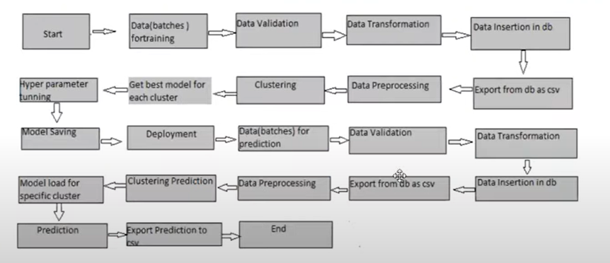
Architecture

Slide 6
Model Training
Data export from DB
The data imported from database in csv format from model training
Data preprocessing
performing EDA to get insights of data like and define distribution outlier trend among data.
Check all values in the columns if present improve the null values. Encode categorical values with numerical values.
Perform the standard scaler to scale down the values
Clustering K means algorithm is used to create class 10 feet process data the optimal number of clusters selected by plotting the elbow plot and put the dynamic selection number of cluster using any locator function the idea behind the clusters to payment if an algorithm for structured data. K means model strained over pre-process data and model state for the use in prediction.

Slide 7
Model selection
after the cluster created the find the best model for each cluster by using two algorithms SVM and XGboost for each cluster both the hyper to algorithms are used to calculate the AUC scores for both the models and select the model with best AUC score similarly the model selected for each cluster and all the models with sister safe for use in prediction

Slide 8
Prediction
testing files are shared in batches and we perform the same validation operation data tranformnation and data insertion on them.
the accumulated data from database and export in csv format for prediction
processing technique on it
k-means model created during the training is loaded and cluster for preprocessed data is predicted.
Based on the cluster number respective model is loaded and use to predict the data for cluster
Once prediction is done for all cluster. The prediction are saved in csv format and shared

Slide 9
Question and Answers
1. What is the source of the data for training is provided sent by client in multiple batch in East data contain multiple files
2. What were the type of data
data was combination of categorical and numerical variables 3.what is the complete flow you followed in this project
refer 5th slide for understanding.
4. How locks are managed
we are using different log as per step form validation in modelling like file validation log data insertion model training log prediction
5. What technique were using for data preprocessing
removing unwanted attributes removing outliers scaling a data

